Slide 1


Business Intelligence vs Predictive Analytics
Notes:
Business Intelligence and Predictive Analytics are two complementary frameworks that are often confused. In this presentation, we will describe the scope of each, highlight the differences between the two, and finally explains the complementary relationship between these two frameworks.

Slide 2
What is a Business Intelligence (BI) System?
According to one definition, BI is a set of software processes that enables business users to see and use large amounts of complex data
In other words, BI makes it easy for business users to better understand the data and what the data represents
BI does not seek to do anything beyond telling a story about what the data is saying. Data aggregation and summarization are the key in BI elements of BI systems.
BI is sometimes referred to as descriptive analytics
Notes:
So let us start with the definition of business intelligence systems. Generally, business intelligence systems are defined as a set of software processes that enable a user to gain an understanding of large volumes of business data. This is done by summarizing the data in an effective way so that it becomes understandable for users. In other words, business intelligence solutions do not try to do anything but to effectively summarize and aggregate the data that so that it can be easily interpreted. A data dashboard system is an excellent example of a BI tool where the dashboard is connected to various data sources and information is summarized and presented to the user in a visually appealing fashion. Because of that, BI solutions sometimes are also referred to as Descriptive Analytics since their primary task is to describe what the data represent.

Slide 3
What is Predictive Analytics?
In predictive analytics, various algorithms are deployed to mine data to find patterns with the goal making predictions.
Predictive analytics systems deploy more complex algorithms and are more computationally intensive
In Predictive Analytics systems the focus is in predicting the future as opposed to describing what has happened in the past which is the focus of BI systems.
Notes:
Now let us move to Predictive Analytics. Predictive analytics is more recent and different to traditional business intelligence systems in a way that in here the goal is to deploy various algorithms to mine massive volumes of data in order to find significant patterns in data that can reveal valuable business insights. The idea is not just to look at what the data represents but to go one step beyond and to be able to predict some aspect of the business using the available data. As a result, predictive analytics systems are normally much more complex and a are more computationally intensive compared to BI platforms.

Slide 4
BI Versus Predictive Analytics?
 | Business Intelligence | Predictive Modelling
Key principle | Summarizing Data | Finding Patterns in Data
Time Frame Focus | Past | Future
Algorithm Complexity | Low | High
Maturity of Products | Mature | Relatively New
Notes:
So here is the summary of the differences between the BI and Predictive Analytics frameworks. As we saw earlier, BI systems are generally used to summarize and aggregate the data whereas, in predictive modeling, we are deploying algorithm to find patterns in the data that are significant and can reveal valuable business insights. In terms of the time frame, the focus of the BI solutions is on the past since the idea is to describe what has happened. For predictive analytics, however, we seek to deploy models to tell us what will happen in the future. As a result, most of the BI solutions are simple in terms of the algorithm and include only data aggregation and summarization and are computationally very basic. Predictive modeling on the hand is more intensive as it needs to distinguish between robust signals and the noise in the data. Finally, BI solutions have been around for a while. Meanwhile, the emergence of predictive analytics solutions is more recent.

Slide 5
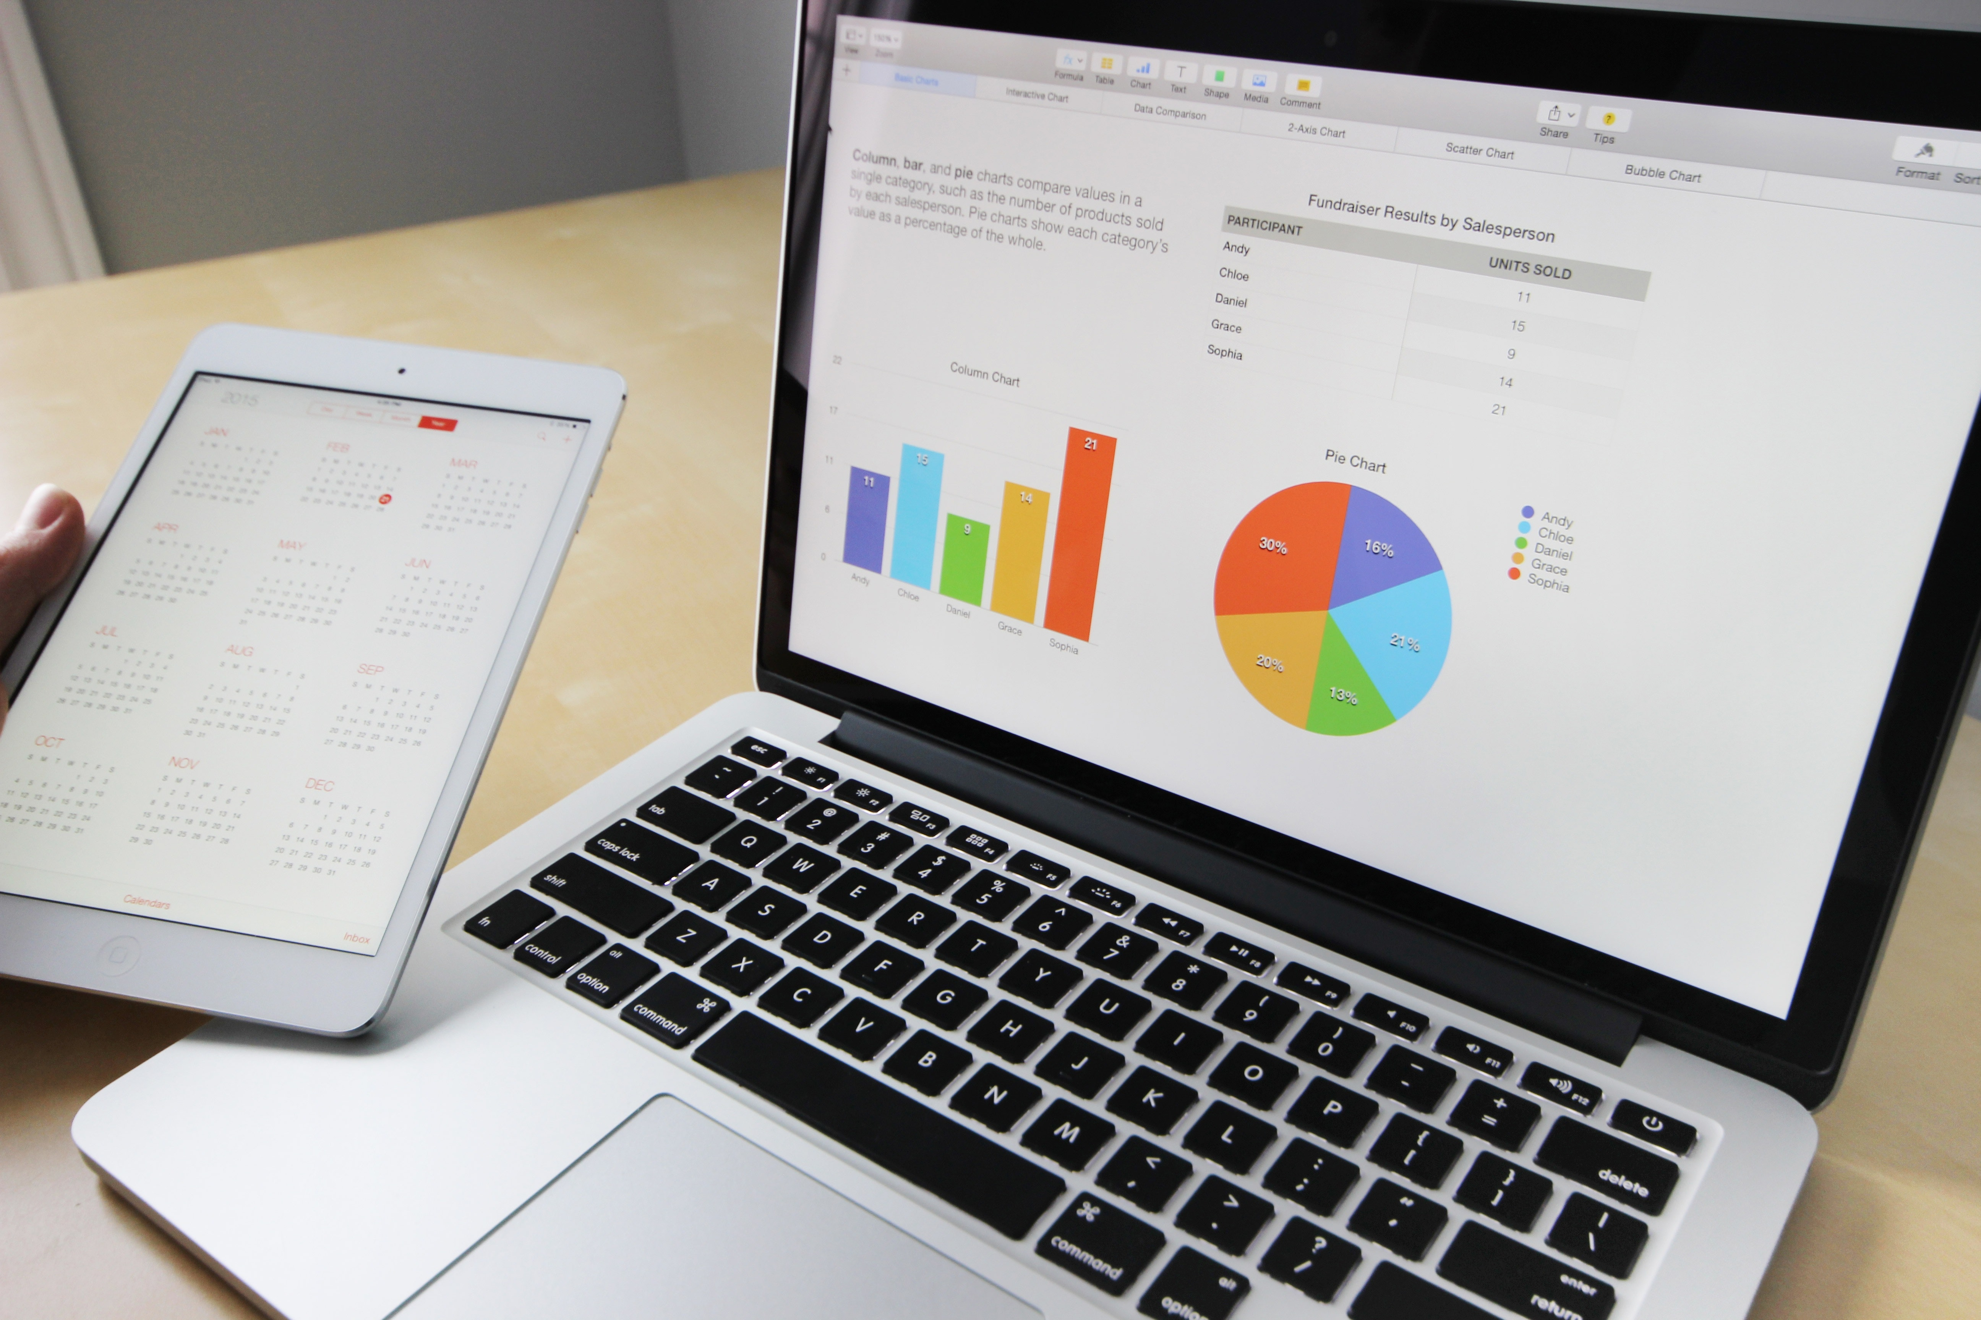

Examples
Business Intelligence
Predicting share prices on the stock market
Predicting if a bank customer can pay their loan if their are approved for one
Predictive Modeling
Automatically generated reports of sales over the past 10 years for different branches
Statistics about the demographic of the current customers of a bank
Notes:
So let us examine a few examples of business intelligence and predictive modeling systems here. For business intelligence, an example is a system that can automatically generate reports of a sales of a company over the past years at different branches and locations. This can be done by collecting data and computing statistics of sales from various data sources. Another example is when a bank wants to collect statistics on the demographics of their customers. This includes statistics on the age, education, and occupation status of their customers. Predictive modeling is more complex. An example is predicting the share prices of a given company on the stock market. In this case, a model should be developed to predict the share prices from all available data sources including company information and performance as well as the information about the sector and industry and relevant macroeconomic factors, etc. Another example is predicting if a bank customer can re-pay their loan if they are approved. In this case, various sources of information including past payment records and current financial obligations of the applicant are examined to determine her creditworthiness for the loan.
Pictures are copyright free: https://www.pexels.com/photo/black-blue-and-red-graph-illustration-186461/ https://www.pexels.com/photo/business-charts-commerce-computer-265087/

Slide 6
“Firms have spent many years building enterprise data warehouses (EDWs) and using business intelligence (BI) tools to report on the business. But predictive analytics is different – advanced statistical, data mining and machine learning algorithms dig deeper to find patterns that traditional BI tools may not reveal.” -- Mike Gualtieri, Forrester Research
In predictive analytics, various algorithms are deployed to mine data to find patterns with the goal making predictions.
Predictive analytics systems deploy more complex algorithms and are more computationally intensive
In Predictive Analytics systems the focus is in predicting the future as opposed to describing what has happened in the past which is the focous of BI systems.

